Slide 1
Intro to Team Project
Prof. Kline
CIS3400 Database Systems
5-<number>

Slide 2
Team Project
The course requires that students complete a team project. Teams will go through the entire database development process from E-R model to normalization, creating tables, queries, views, forms and reports.
Project development activities are facilitated by research, team discussion, class lectures and labs.
Teams consist of 3 – 4 members.

Slide 3
Project Ideas
You are encouraged to come up with projects of your own – from work (so long as data is not proprietary), student groups/clubs, social organizations. The project ideas listed below can also serve as a guide or as inspiration for a project topic….All the following ideas will need to be expanded….
Scheduling Application - A consulting company has a lunch room, 12 conference rooms, 6 LCD projectors, 3 portable PCs, etc. They need to be able to schedule each of these resources for a given day and time period and avoid conflicting use of resources. Also, management would like reporting on resource utilization per week, month, year. They are also considering renting out resources to other companies if resource utilization is low. Queries might include:
When is the next day resource X is free between 1:00 and 5:00.
How many hours per week on average is conference room X occupied.
Supply Cabinet - A company centrally maintains supplies for each of its branch offices. They need a database to keep track of what they have in stock, requests from branch offices for supplies and purchasing of supplies from vendors. Should keep track of the vendor with the best price for a particular supply. They would also like to minimize shipping costs by shipping several supplies at one time to a given branch office. Queries might include:
When should supply X be replenished
How many shipments, on average, go out to the branch offices per week ?
Baseball Statistics - A professional baseball team would like to maintain a database that records player statistics on all team members and complete records of every game (on an inning-by-inning basis). Each player would have a set of offense and defense statistics. Queries include:
What is the batting average for player X
Who is the best relief pitcher to use against a left-handed batter
5-<number>

Slide 4
1. Develop a proposal for the project
First, groups should identify the database system application they want to design.
Informal discussions with the instructor can help define the project.
Groups should not continue working on the project unless reviewed and approved by the instructor.
Project proposals will include:
A narrative description of the business used for the project or application being created. This should include a description of the problem or opportunity being addressed.
Identification of information needs – what information would help solve the problem or allow a system user to take advantage of the opportunity.
Initial list of entities that have been identified. This should come from the above.
Distribution of duties for the project, with team member names and roles.
5-<number>

Slide 5
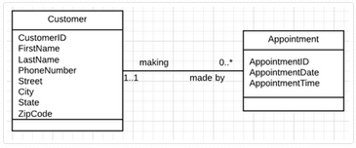
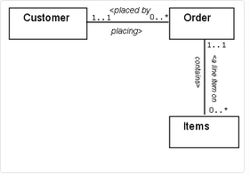
2. Systems Analysis
This step derives an Entity Relationship (E-R) diagram using UML notation from the project proposal / user requirements (Step #1).
Students should use a E-R modeling tool such as MS Visio, Gliffy, LucidChart, etc. to complete this work. See the slide at end of this deck for possible tools.
Note: The "Relationship View" in MS Access is not an E-R modeling tool.
Examples of an E-R diagram:
http://holowczak.com/drawing-entity-relationship-diagrams-with-uml-notation-using-lucidchart/
5-<number>

Slide 6
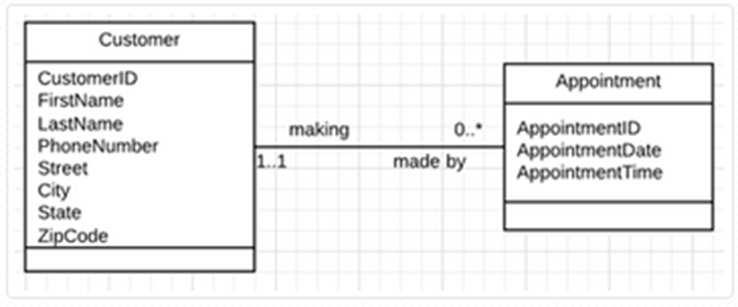

3. Relational model
This step converts the E-R entity diagram into a relational logical or conceptual model. During this conversion, primary keys are identified and foreign keys are propagated to the relations. For this step, all that is needed is essentially a UML class diagram with relationships.
Example of relational (logical) model:
(PK)
CustomerID (FK)
5-<number>

Slide 7
3. Relational model, cont.
For a majority of conversions of ER Models, the following general steps apply:
Entities – In general, each entity will be converted directly to a relation.
The attributes of the entity become the attributes of the Relation.
The Identifier of the Entity becomes a Key of the Relation.
Relationships will be mapped as “Foreign Keys”.
There are a number of variations to this step that will be described in mroe details below.
Exceptions include many : many relationships, inheritance models.
5-<number>

Slide 8
4. Normalization
The team will next convert the relational model through a process of normalization to derive a physical model or database schema. This step will require the team to list all of the functional dependencies** prior to putting the relation in 3NF. For normalization, students are responsible from 1NF – 3NF, with some discussion of BCNF. The main focus is on 3NF. Also, teams are to indicate possible examples of de-normalization and why it was done.
Input to this process is the work completed in Step #3 –relational (logical) model.
Output of this process will be a set of schema that are at minimum 3NF compliant.
Example:
Customer (CustomerID, FirstName, LastName, PhoneNumber, Street, City, State, ZipCode)
Appointment (AppointmentID, ApprointmentDate, AppointmentTime, CustomerID )
Underline = PK, Italicized = FK
This process may result in changes to the relational (logical) model as represented in Step 3.
** Prior to completing normalization, teams will develop either : a) the relation and functional dependencies; b) the relation and non ambiguous sample data; or c) the relation and a non ambiguous description of the data.

Slide 9
5. Midterm project deliverable
Having completed steps 1 – 4, the team will need to submit a midterm project deliverable. Submit your work in the form of a powerpoint document.
The name of the project, and names of the team members are to be listed on the title page with the tasks that each member completed.
Submission is by one team member only.
Please submit output from Steps 1 through 4.
The team project proposal
1 high level E-R diagram
1 relational model with PKs and FKs
1 normalized model with functional dependencies of each relation and the transformation of relations into 3NF as represented by normalized schema.
5-<number>

Slide 10
6. Database Implementation using Access
Following approval of the midterm deliverable, groups should then implement the database tables from the normalized set of relations created in Step #4.
For each normalized relations, write a SQL CREATE TABLE statement.
Write separate ALTER TABLE statements to add PRIMARY KEY and FOREIGN KEY constraints to the tables.
Data should be supplied for each table by writing SQL INSERT statements. Teams should provide enough data to enable subsequent queries involving single and multiple tables and demonstrate why a database was required in the first place.
All SQL DDL statements and the resultant tables must be saved in Access.
Do not neglect using update and delete SQL.
Some experience with Access wizards for table creation is also recommended.
5-<number>

Slide 11
7. Application implementation using Access
In this step the application (forms, reports, queries, triggers, views, etc.) is created on top of the tables. A combination of SQL and Access wizards can be used to complete output of this step.
This step requires the team to create a number of application deliverables:
Queries - provide the SQL DML statements and associated statement of purpose. Queries should include join and subquery, accessing up to 3 – 4 classes, for retrieval of information of key business processes.
Two forms that reflect the core of the business accompanied by a description of each. For example, if the business takes orders from customers, develop a form with Orders and Order items with lookups for customers and products or services.
Two reports that reflect the core of the business.
A narrative description of VBA code that is used to embellish a form.
5-<number>

Slide 12
8. Final Project Deliverable & Brief Presentation
Having completed steps 6 – 7, please submit the team’s work as a final project deliverable. Submit your work in the form of an Access file (databaseName.accdb) using the upload link provided. A Word document may be used to submit any descriptive narratives.
The name of the project, and names of the team members are to be listed on the link to upload your work to Blackboard.
Submission is by one team member only.
Final project deliverable is not accumulative. It includes output from Steps 6 and 7.
In addition to submitting output from Steps 6 & 7, a short narrative description that describes:
  The groups experience (e.g. which step is easiest, hardest?)
  What you learned that you did not expect to
  What you would have done differently
  Benefits of the proposed system
  Final comments
Decide upon contents of brief presentation to class. Highlights.
5-<number>

Slide 13
Project Milestones – See Syllabus
Midterm deliverables due - week 8 (Steps 1 – 5)
Final project report due - week 13 (Steps 6 – 7 only, non-accumulative)
Short oral presentation in class – week 14 & 15
No late work permitted

Slide 14
Sample UML E-R Modeling Tools
Visual Paradigm
http://www.visual-paradigm.com/solution/freeumltool/LucidChart
Gliffy https://www.gliffy.com/
lucidChart https://www.lucidchart.com/
MS Visio

